Slide 1

SENIOR ASSEMBLY
Congratulations
Class of 2017!
Notes:
1

Slide 2

CLASS OF 2017 SENIOR THEME
“The present is where everything begins”
Carlos Santana

Slide 3
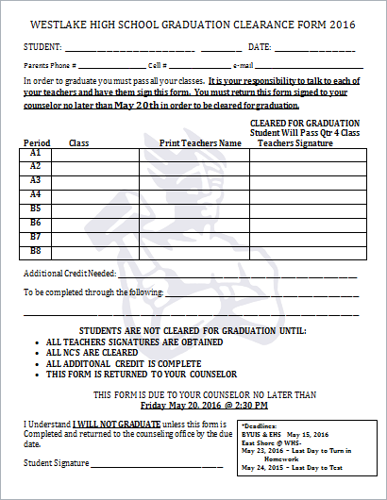
CLEARANCE FOR GRADUATION
May 4th – May 22nd
EVERY STUDENT will need ALL of their teachers to sign off this form guaranteeing they will pass their class for 4th term.
IMPORTANT DATES:
May 2 - Begin Handing out Clearance forms
May 2 - May 20 - Students can turn in Clearance forms
May 20th - Deadline for clearance forms
May 25 - All NC's must be made up by this day in order to participate in graduation ceremony
May 20 - May 25 - Can still clear, but it's after the deadline

Slide 4
Civics Test
All Seniors MUST take and pass the civics test in order to graduate.
Info and link for test can be found on the Westlake home page.

Slide 5
SENIOR EVENING OF EXCELLENCE
May 17th
To honor and recognize seniors for their outstanding achievements. This includes CTE achievement, scholarships awarded, Regents, and Sterling Scholar achievements, etc.
If you have received a scholarship this year, please make sure you fill out the form by May 1st so we can recognize those achievements.
7:00pm in the WHS Auditorium
Best Dress Required
No Cost for this Event
This year, LifeTouch will be taking pictures in front of the iconic “W” at this night, instead of graduation.

Slide 6
Regents/ Utah Scholars
utahscholars.org
#1 -Utah Scholars Sign Up Form .
#2 - Utah Scholars Recognition Application: closes March 31

Slide 7


Slide 8
CLEAR UP FINANCES
Seniors! Please make sure that you are free of all fines and fees!!
FINES/FEES WILL PREVENT YOU FROM BEING CLEARED FOR GRADUATION!
FINES/FEES WILL PREVENT YOU FROM PICKING UP YOUR YEARBOOK AND CAP AND GOWN!

Slide 9
CAP & GOWN/YEARBOOK DISTRIBUTION May 23rd
11:00AM- 1:00PM in the MAIN GYM
CAP & GOWN (come with tassel) . If you still need to order go to jostens.com COST = $42.50
STOLES – Belong to WHS! Will be handed out with cap & gown but must be returned at diploma pick up point.
HONOR CORDS - If you are an high honor (3.9-4.0; 2 cords) or honor roll (3.7-3.89; 1 cord) student, you will be expected to wear gold honor cords. March 24th is the last day to find out if you’re eligible for cords. National Honor Society will be expected to wear light/dark blue cords (paid for by NHS). The cords are $6 each and can be paid for in the finance office.
YEARBOOK - If you have purchased a yearbook you will be able to pick it up during this time. After 1:00pm yearbooks will be distributed early at the stomp.
ALL FEES AND FINES MUST BE CLEARED OR YOU WILL NOT BE ALLOWED TO PICK UP YEARBOOKS AND GRADUATION MATERIALS.

Slide 10
GRADUATION PRACTICE
May 23rd
8-10am
THIS IS MANDATORY
All seniors who will be walking/graduating, must report to the Main Gym by 8am
Important Graduation Information will be received
Seniors will walk through the graduation ceremony.

Slide 11
GRADUATION CEREMONY
May 26TH
Graduates are to be at the Marriott Center @ BYU at 7:30AM
Graduation starts at 8:45AM
Importance of the day—act appropriately and remember how we want Westlake represented
Leis or any items other than the specified apparel will not be allowed
Semi-formal dress is required
  Boys—shirt/tie, slacks, dress shoes
  Girls—dresses/skirts, dress shoes

Slide 12
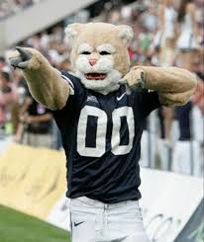
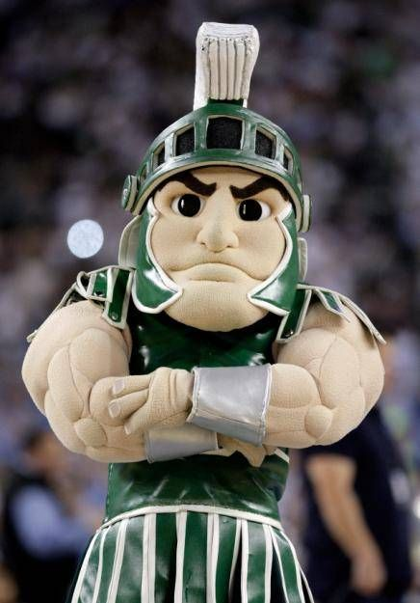
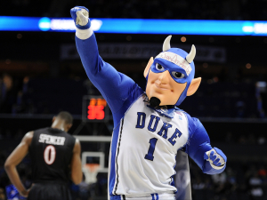
SENIOR CLASS PROJECT

Slide 13
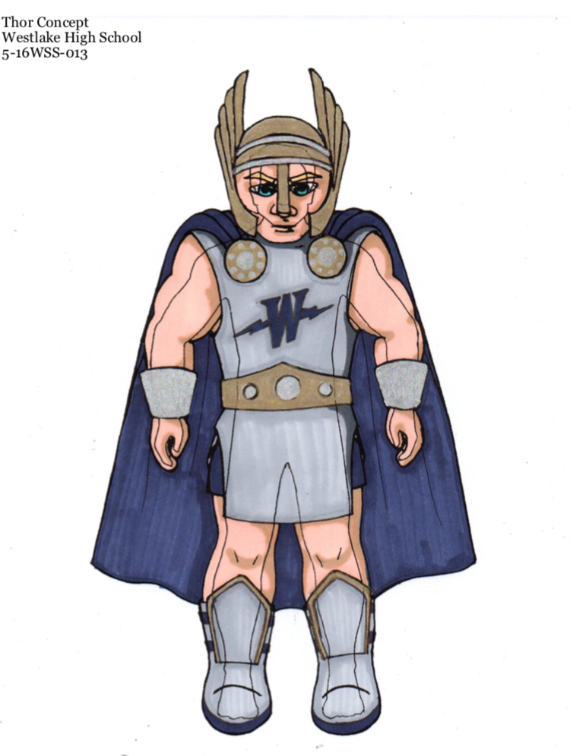
THOR MASCOT DESIGN

Slide 14
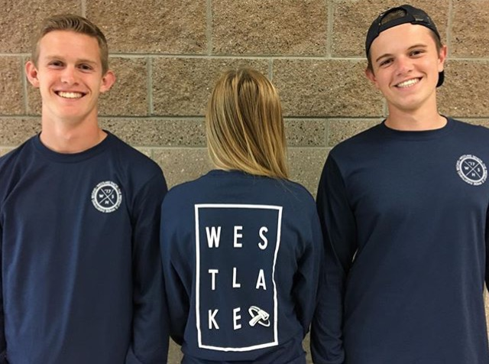

SENIOR SHIRTS

Slide 15
TIME TO PARTY!
SENIOR WEEKS!
May 16th-May 26th

Slide 16
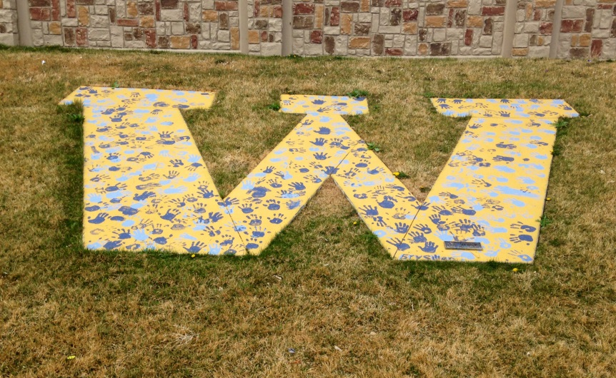
Senior Activity Day May 16th
These activities will take place May 16th – Please watch for incoming information!
CLASS PHOTO - At the completion of this project we will schedule a class photo to hang in the commons area.
TRADITIONS - At this time we will also continue the tradition started in 2011 and place our handprints on the Football Field “W”!

Slide 17
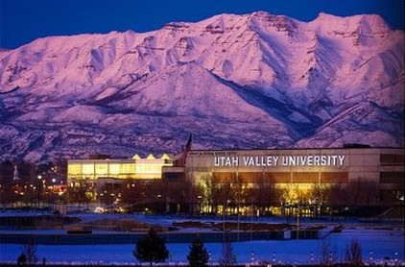
UVU GRAND BALLROOM

Slide 18
SENIOR DINNER DANCE
May 16th
At UVU Grand Ballroom
Tuesday 6pm – 10:00pm
Dinner Served at 6:45pm
This is FOR WHS SENIORS ONLY and is a semi-formal event
This is not a date dance
Hand in slip with your choice of Roasted Chicken Caprese or Baked Ziti Primavera (Pasta w/ Pesto sauce) when you pay in the finance office.
Senior Superlatives will also be announced
Tickets to this event must be purchased by May 5th
Cost: $25/person

Slide 19
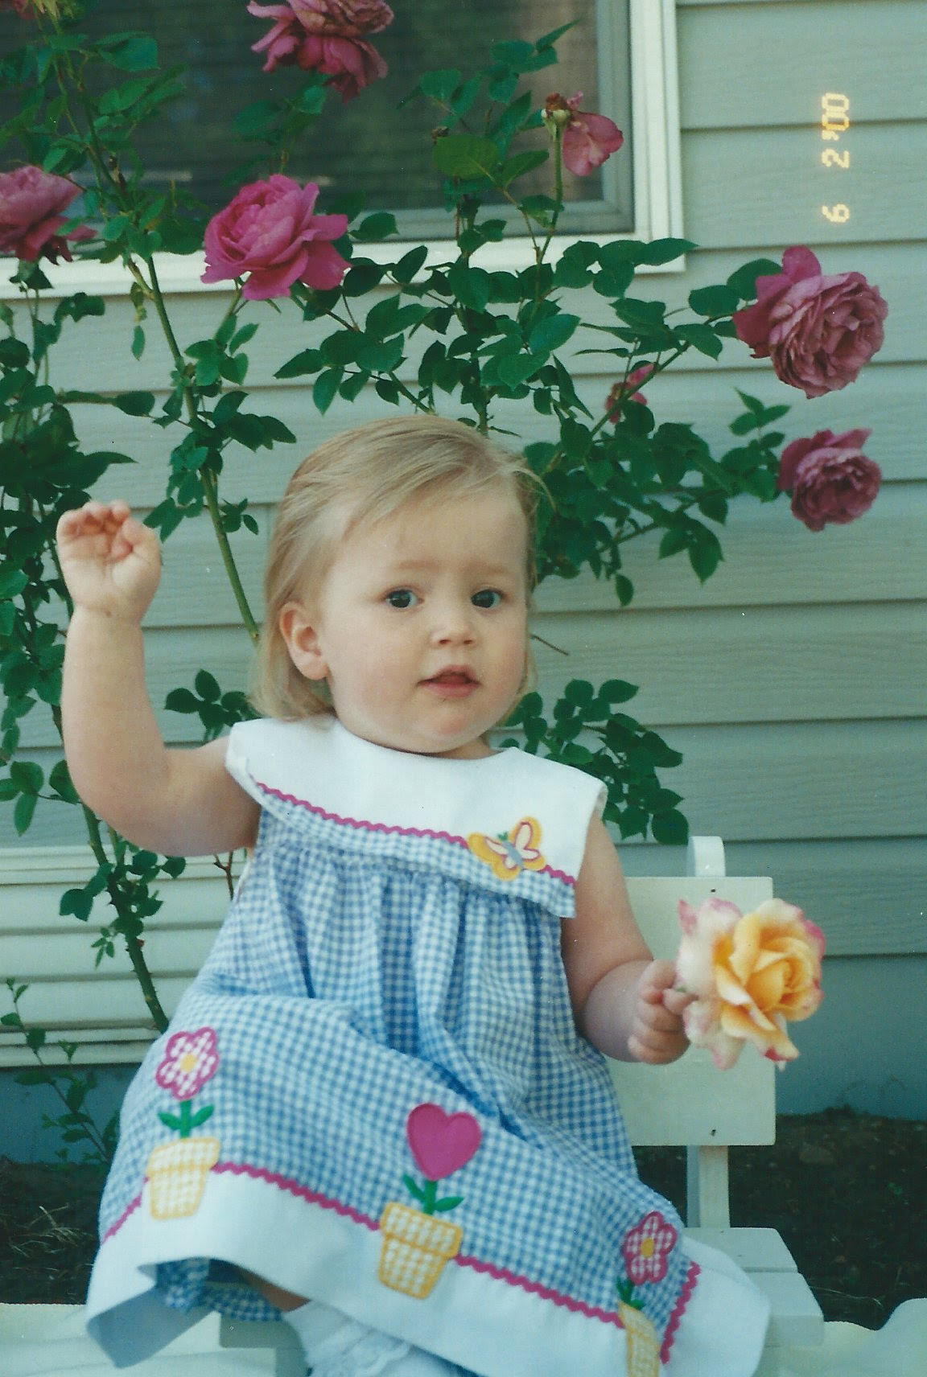

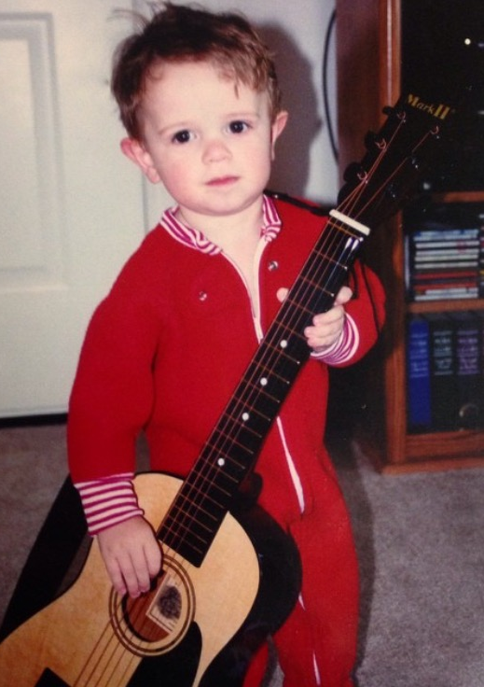
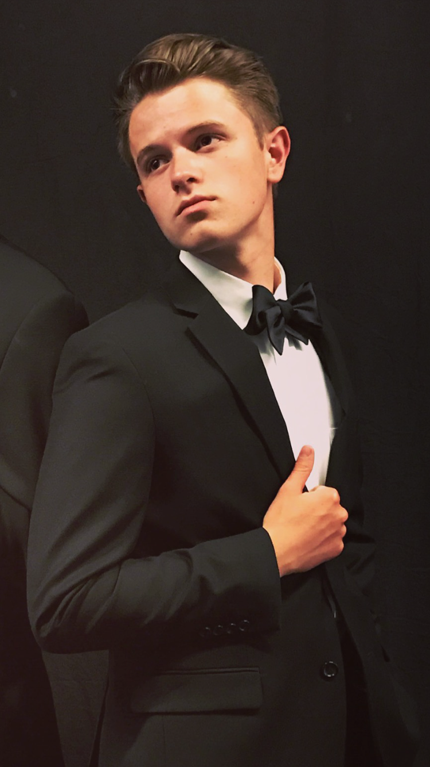
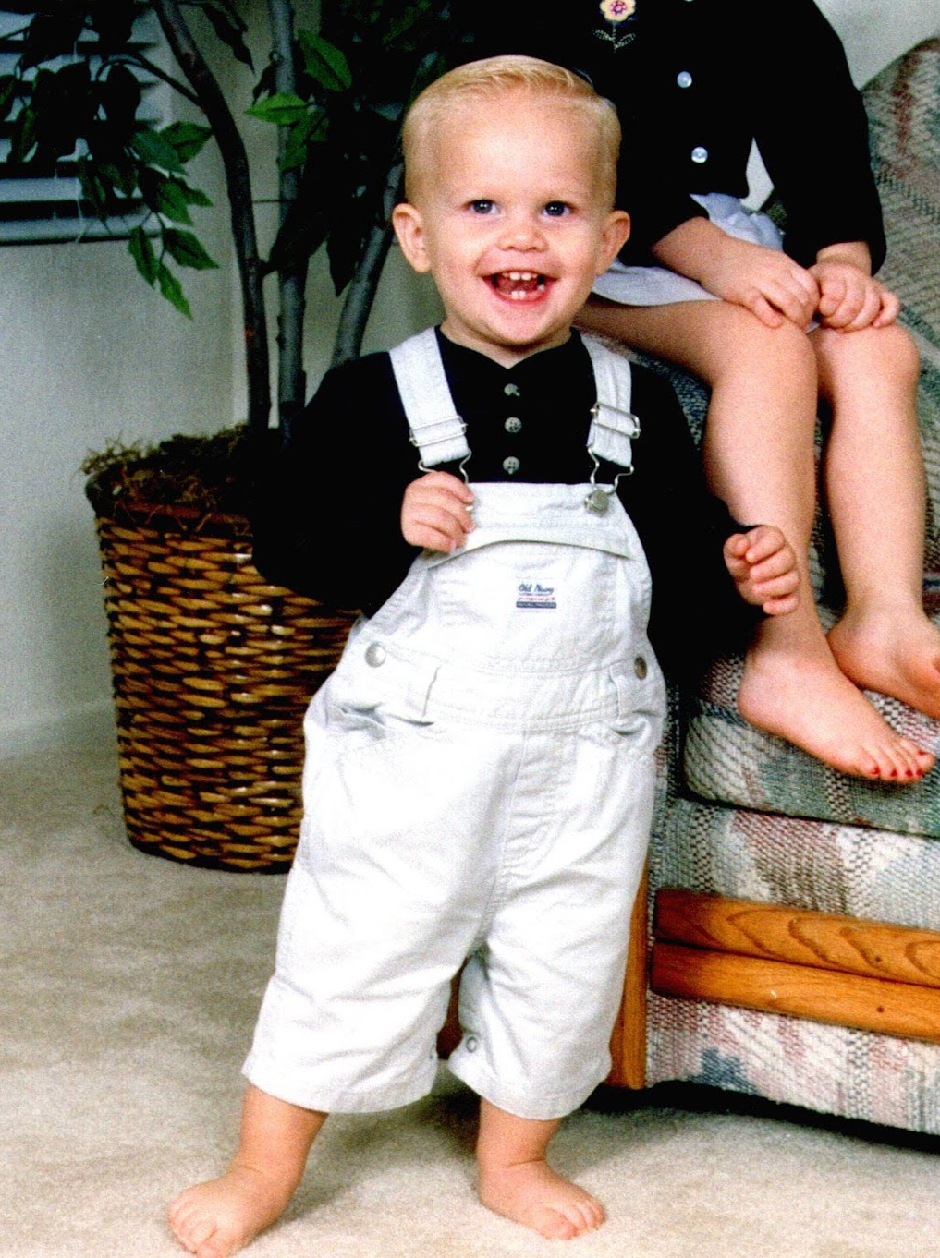
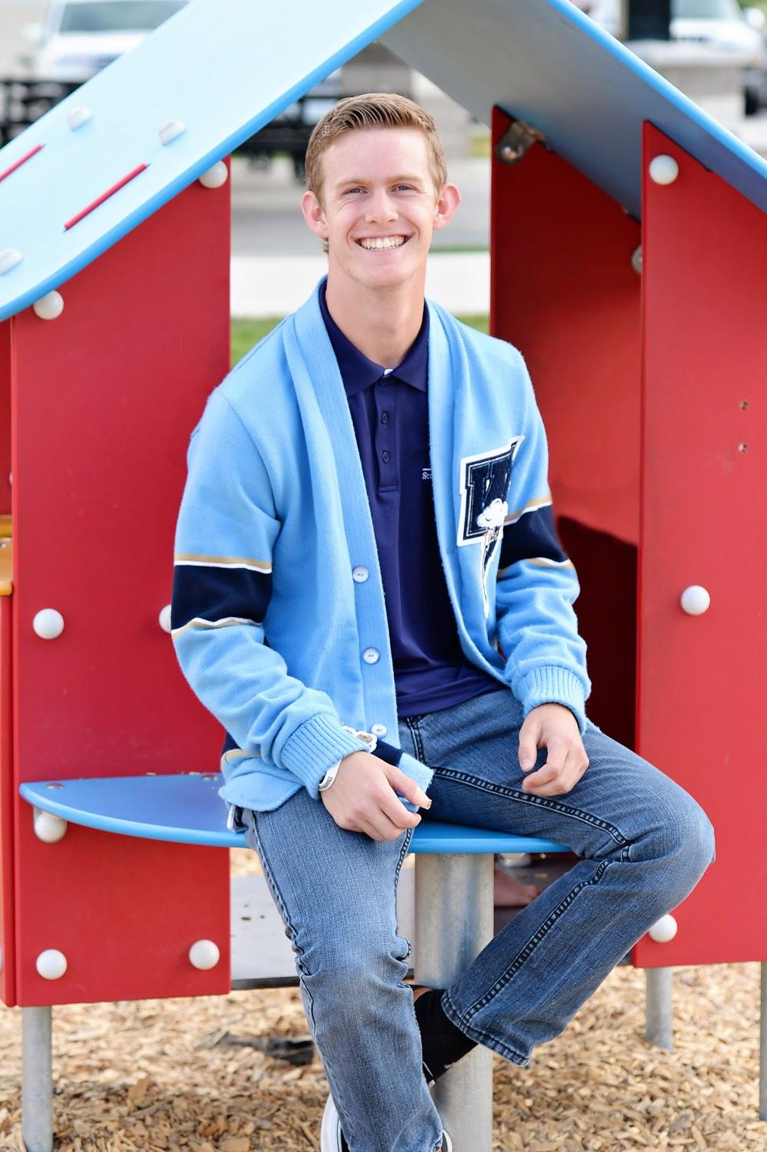
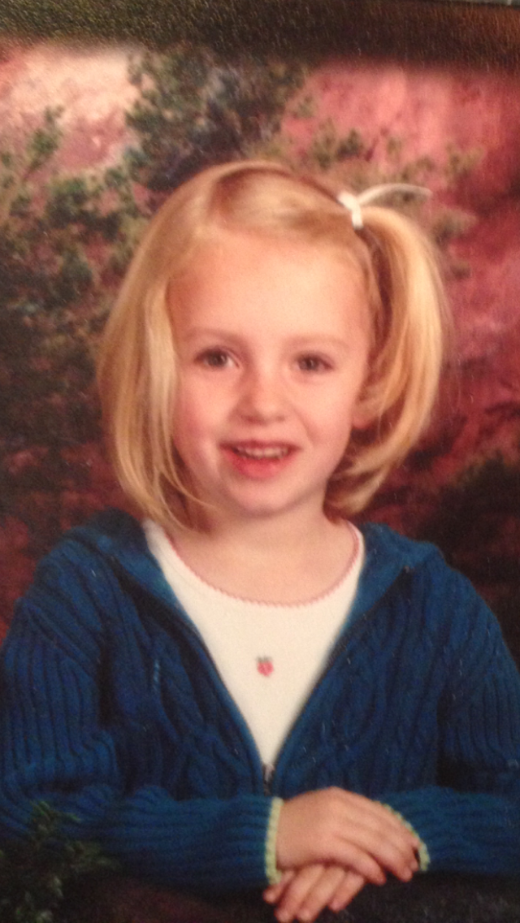

SENIOR AND BABY PHOTOS
Send your photos to westlakeclassof.2017@gmail.com or DM @westlakeclassof_2017

Slide 20
LAGOON DAY
May 18th
Seniors ONLY!
Check in at 7:45am, Leave at 8am, Return approx. 6pm
No private vehicles will be allowed in the park, therefore students must ride the buses up and back.
Students are responsible for their own lunch.
Cost is $55/person
Tickets are presale only in the finance office by May 12th - OR UNTIL BUS SPACE ALLOWS!

Slide 21
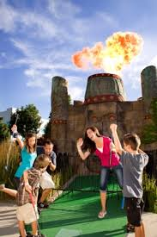



BOONDOCKS FUN CENTER

Slide 22
ALL NIGHT GRAD
PARTY May 26th
8:15-8:30pm, check in and Comedy Sportz Show
Bus will leave promptly at 9:15pm.
Boondocks Fun Center 10pm-3am
$35/person
$50 person at the door (CASH AND CARD)
ALL SENIORS MUST RIDE THE BUS TO GRAD NIGHT ACTIVITES.
FREE FOOD (Pizza from 11:00pm until 12:00am)
Unlimited drinks the whole time!

Slide 23
COST BREAKDOWN
Senior Dinner Dance $28
Senior Activity Day FREE
Senior Grad Night Party $35
Lagoon Day $55
Senior Shirt $12
TOTAL $ 130
Package Deal #1 - $125
Includes a discounted senior shirt!
*Deadline for Package Deal/Dinner Dance/Lagoon Day is May 5th or when busses are full!*

Slide 24
PAYMENT OPTIONS
You can pay with check, cash or in person by debit/credit card.
Online Payment is also available. Go to WHS Website – My School Fees – Senior Activities Package 2017 (only the package deal online)
Absolutely no refunds!!
Tickets for all events will be sold starting Friday, March 24th.
PACKAGE DEAL (ALSO DINNER/DANCE & LAGOON) CUT OFF DATE – Thursday, MAY 5th! DON’T MISS OUT!!!

Slide 25
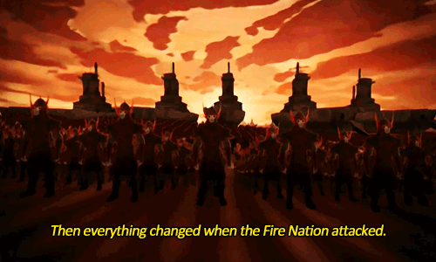
Spirit Bowl
Friday, March 24th
Seniors are FIRE NATION
Wear RED, and meet outside
If you would like to compete, DM @westlakeclassof_2017 on Instagram

