Slide 1
SENIOR ASSEMBLY
Congratulations
Class of 2016!
Notes:
‹#›

Slide 2
CLASS OF 2016 SENIOR THEME Now this is not the end. It is not even the beginning of the end. But it is, perhaps, the END of the BEGINNING.

Slide 3
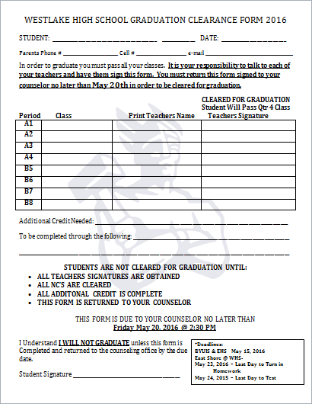
CLEARANCE FOR GRADUATION May 4th – May 22nd
EVERY STUDENT will need ALL of their teachers to sign off this form guaranteeing they will pass their class for 4th term.
IMPORTANT DATES:
May 2 - Begin Handing out Clearance forms
May 2 - May 20 - Students can turn in Clearance forms
May 20th - Deadline for clearance forms
May 25 - All NC's must be made up by this day in order to participate in graduation ceremony
May 20 - May 25 - Can still clear, but it's after the deadline

Slide 4
Civics Test
All Seniors Must take and pass the civics test in order to graduate.
Info and link for test can be found on the Westlake home page.

Slide 5
SENIOR EVENING OF EXCELLENCE May 17th
To honor and recognize seniors for their outstanding achievements. This includes CTE achievement, scholarships awarded, Regents, and Sterling Scholar achievements, etc.
If you have received a scholarship this year, please make sure you fill out this online survey by May 1st so we can recognize those achievements.
Please visit: https://docs.google.com/a/alpinedistrict.org/forms/d/1A2IioP3jHK4gTgkJ2inrM-V6w99Iho7zQ__tVZs9HzE/viewform?c=0&w=1
7:00pm in the WHS Auditorium
Best Dress Required
No Cost for this Event

Slide 6
GRADUATION SPEAKERS
Students who are on track for graduation and want to speak at graduation can try-out for a speaking part on April 28th & 29th
You can sign up for an audition time outside Mrs. Bos’s room (D258) BEFORE APRIL 28th
Senior Class Theme
“This Is Not The End”
Fill out application (on back of flyer) and prepare a 2 min speech.

Slide 7
CLEAR UP FINANCES
Seniors! Please make sure that you are free of all fines and fees!!
FINES/FEES WILL PREVENT YOU FROM BEING CLEARED FOR GRADUATION!
FINES/FEES WILL PREVENT YOU FROM PICKING UP YOUR YEARBOOK AND CAP AND GOWN!

Slide 8
GRADUATION PRACTICE May 24th
8-10am
THIS IS MANDATORY
All seniors who will be walking/graduating, must report to the Main Gym by 8am
Important Graduation Information will be received
Seniors will walk through the graduation ceremony.

Slide 9
CAP & GOWN/YEARBOOK DISTRIBUTION May 24th
11:00AM- 1:00PM in the MAIN GYM
CAP & GOWN (come with tassel) . If you still need to order go to jostens.com COST = $42.50
STOLES – Belong to WHS! Will be handed out with cap & gown but must be returned at diploma pick up point.
HONOR CORDS - If you are an high honor (3.9-4.0; 2 cords) or honor roll (3.7-3.89; 1 cord) student, you will be expected to wear gold honor cords. National Honor Society will be expected to wear light/dark blue cords (paid for by NHS). The cords are $6 each and can be paid for in the finance office.
YEARBOOK - If you have purchased a yearbook you will be able to pick it up during this time. After 1:00pm yearbooks will be distributed early at the stomp.
ALL FEES AND FINES MUST BE CLEARED OR YOU WILL NOT BE ALLOWED TO PICK UP YEARBOOKS AND GRADUATION MATERIALS

Slide 10
GRADUATION CEREMONY May 26TH
Graduates are to be at the UCCU Center @ UVU at 3:00PM
Graduation starts at 4:00PM
Importance of the day—act appropriately and remember how we want Westlake represented
Leis or any items other than the specified apparel will not be allowed
Semi-formal dress is required
Boys—shirt/tie, slacks, dress shoes
Girls—dresses/skirts, dress shoes

Slide 11
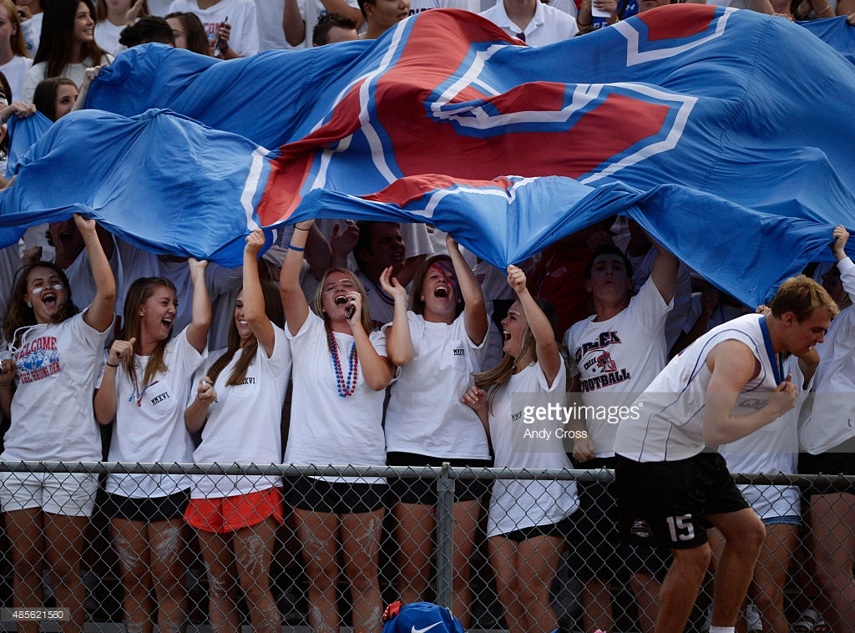
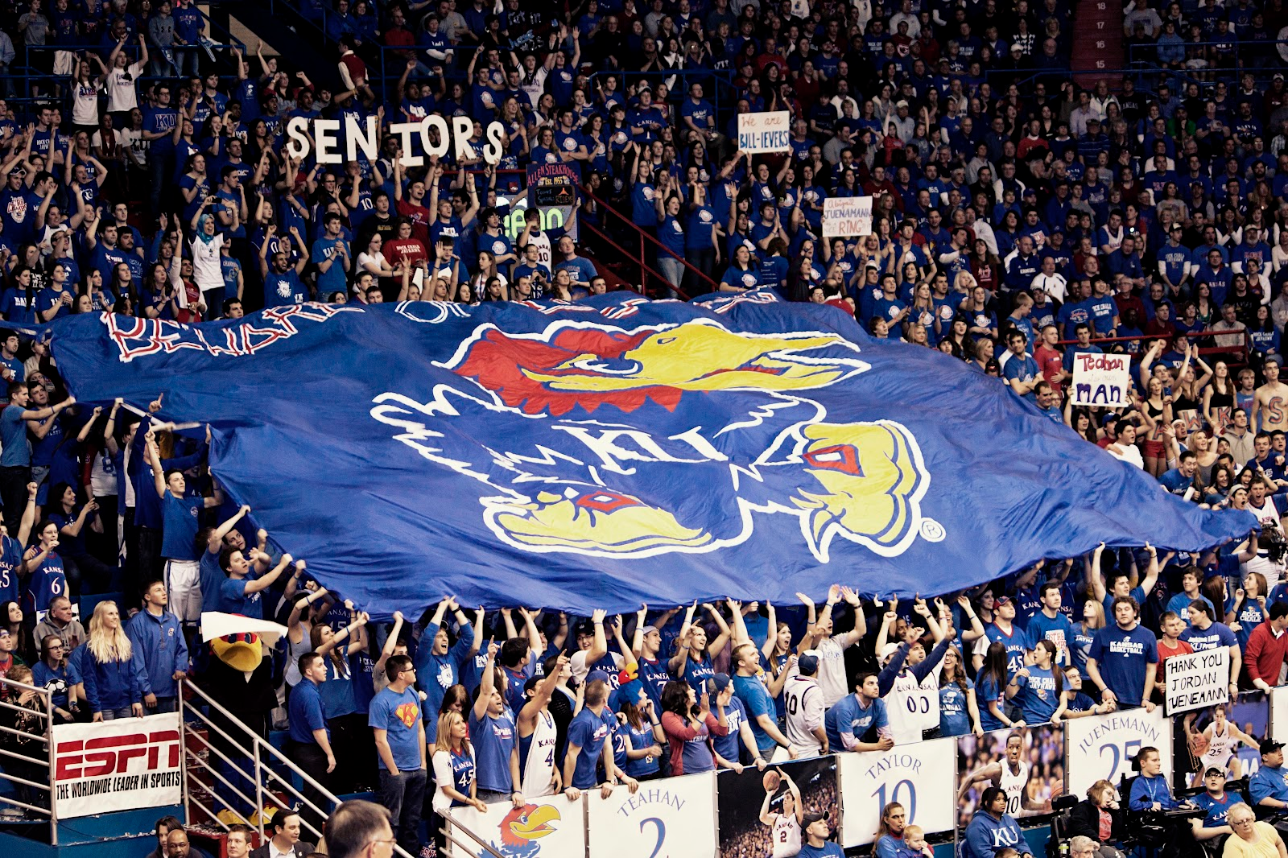
SENIOR CLASS PROJECT

Slide 12
LOGO

Slide 13
SENIOR SHIRTS

Slide 14
TIME TO PARTY!
SENIOR WEEKS!
May 16th-May 26th

Slide 15
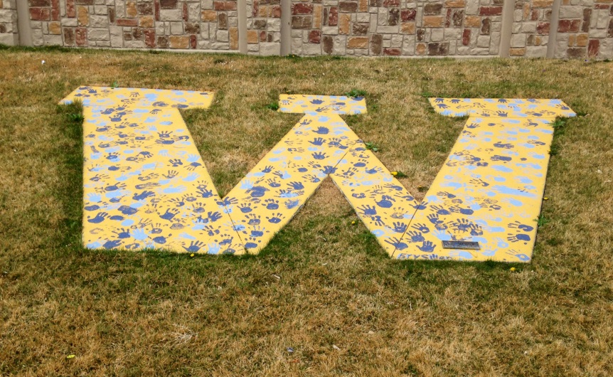
Senior Activity Day May17th
These activities will take place May 17th – Please watch for incoming information!
CLASS PHOTO - At the completion of this project we will schedule a class photo to hang in the commons area.
TRADITIONS - At this time we will also continue the tradition started in 2011 and place our handprints on the Football Field “W”!

Slide 16
UVU GRAND BALLROOM

Slide 17
SENIOR DINNER DANCE May 18th
At UVU Grand Ballroom
Tuesday 5:30pm – 10:00pm
Dinner Served at 6:00pm
This is FOR WHS SENIORS ONLY and is a semi-formal event
This is not a date dance
Hand in slip with your choice of Roasted Chicken Caprese or Cheese Enchilada when you pay in the finance office.
Awards will also be announced
Tickets to this event must be purchased by May 13th
Cost: $25/person

Slide 18
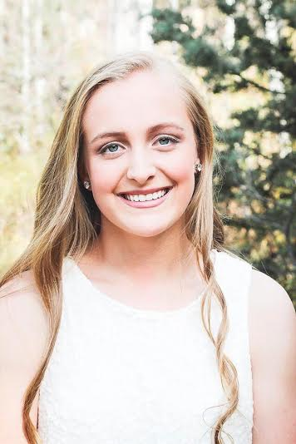
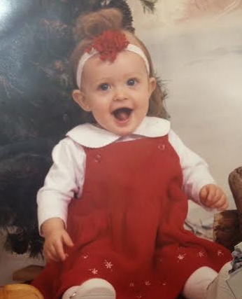
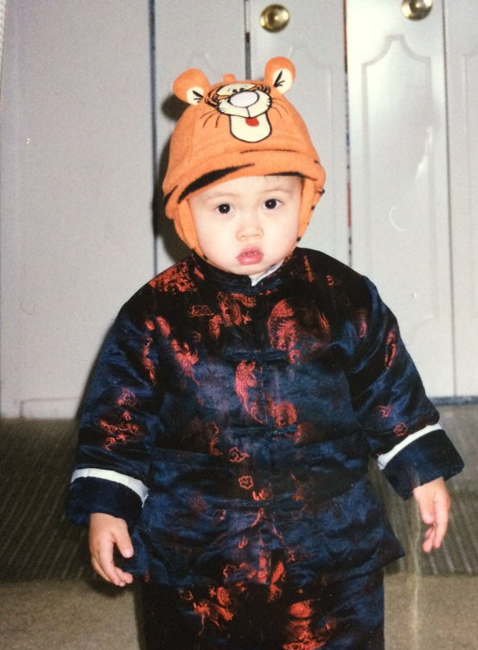
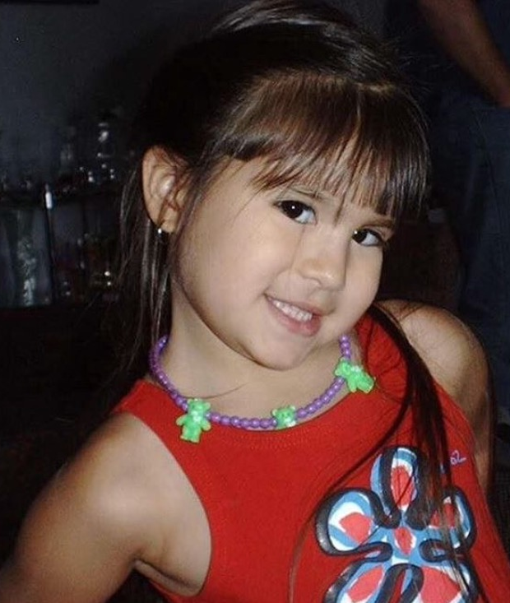
SENIOR AND BABY PHOTOS Send your photos to whssr2016@gmail.com or DM @whs2016_sr

Slide 19
Senior Video
If you have any videos of your first day of school (Kindergarten, 1st grade, etc.) and you want it in the senior graduation video, put the video on a flash drive and bring it to Mr. Schmuhl in room B105!

Slide 20
LAGOON DAY May 19th
Seniors ONLY!
Leave at 8am, Return approx. 6pm
No private vehicles will be allowed in the park therefore students must ride the buses up and back
Students are responsible for their own lunch
Cost is $50/person
Tickets are presale only in the finance office by May 13th - OR UNTIL BUS SPACE ALLOWS!

Slide 21
ALL NIGHT GRAD PARTY May 26th
9:30pm – 4:00am Comedy Sportz Show, Boondocks Fun Center
$35/person
$40 person at the door (CASH ONLY)
Bus will leave promptly at 10 PM. Check in will begin at 9:30pm.
ALL SENIORS MUST RIDE THE BUS TO GRAD NIGHT ACTIVITES.
FREE FOOD Pizza from 11:00 am until 12:00 am
Unlimited drinks the whole time!

Slide 22
BOONDOCKS FUN CENTER

Slide 23
COST BREAKDOWN
Senior Dinner Dance $ 25
Senior Activity Day FREE
Senior Grad Night Party $ 35
Lagoon Day $50
Senior Shirt $13
TOTAL $ 122
Package Deal #1 - $111
The senior class will donate a senior shirt to every senior who buys entire package!
Package Deal #2 - $105 for entire package without the shirt included
*Deadline for Package Deal/Dinner Dance/Lagoon Day is May 12th or when busses are full!*

Slide 24
PAYMENT OPTIONS
You can pay with check, cash or in person by debit/credit card.
Online Payment is also available. Go to WHS Website – My School Fees – Senior Activities Package 2016 (only the package deal online)
Absolutely no refunds!!
Tickets for all events will be sold starting Monday, March 28th.
PACKAGE DEAL (ALSO DINNER/DANCE & LAGOON) CUT OFF DATE – Thursday, MAY 12! DON’T MISS OUT!!!

Slide 25
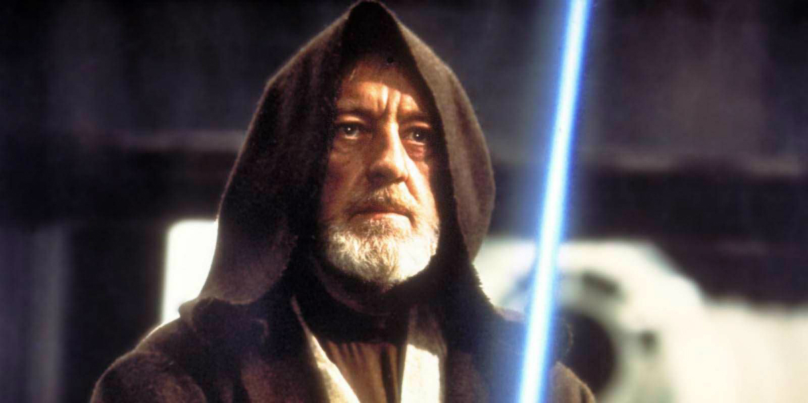
Spirit Bowl
Friday, April 1st
Seniors are JEDIS
Wear BLUE
If you would like to compete, DM @whs2016_sr on Twitter or email whssr2016@gmail.com
May the force be with you.

Slide 26
“WE ARE ALL IN THIS TOGETHER!!”
HAVE FUN AND CELEBRATE!
THIS IS A ONCE IN A LIFETIME MOMENT!
DON’T MISS OUT ON ANYTHING!
CAREFULLY REVIEW ALL THE INFORMATION YOU HAVE RECEIVED!
GIVE MA AND PA THE PUPPY DOG EYES AND THEY WILL HELP YOU FINANCE THIS! WE PROMISE!

